Slide 1

Linear Regression Model Analysis on Public Offenses in New York City
By Jeff Tsui
Springboard Introduction to Data Scientist
Capstone Project

Slide 2

Purpose
The purpose of this project:
Identify the hotspots of public offenses from the past crime reports.
Bring cautions to the locals and tourists
Provide information to the police force, in order for them to determine and adjust the number of police on duty to patrol in a certain area and certain days.

Slide 3

Project Aims
Has the public crime activity in New York City increased or decreased at the end of 2017?
Which borough in New York City have the most public crime complaints?
Is there any correlation between public crime activity and weather temperature?
Which police shift (00:00 - 08:00, 08:01 - 16:00, or 16:01 - 24:00) has the most crime activity?
Where are the hotspots for public offenses?

Slide 4
Data Extraction
This project will look at:
Dataset of Incident Level Complaint Data ( Year 2010 – 2017)
NYC Opendata
Dataset of daily average temperature and daily precipitation
Weather Underground
Dataset of federal holidays
OfficeHolidays
Dataset of public school closed
National Council on Teacher Quality

Slide 5
Important Fields and Information
From the NYC opendata dataset, I will only be using the variables: boroughs, date of the complaints, time of the complaints, level of offenses, description of offenses, description of premises, suspect’s age group, suspect’s race, suspect’s sex, victim’s age group, victim’s race, and victim’s sex.
In the variable description of offenses, I will only be using the data: “arson”, “assault and related offenses”, “dangerous weapons”, “felony assault”, “harassment”, “kidnapping”, “rape”, “robbery”, and “sex crimes”.
In the variable description of the premises, I will only be using the data: “bus stop”, “open areas (open lots)”, “park/playground”, “public buildings”, “street”, “transit (bus)”, and “transit (subway)”.
Splitting the day into 3 time period corresponding to the police shift (00:00 - 08:00, 08:01 - 16:00, and 16:01 - 24:00).

Slide 6
Data Limitations
Since there isn’t a specific whole area weather temperature for the entire New York City that includes all five boroughs on the historical data on the Weather Underground website. I took the average temperature of the most centered borough (Manhattan).
The days that have precipitation greater than 3 inches could be anytime of the day. And it could be continuous or could be broken down into a several times of the day.
There are limited data on the suspect’s age, race, and sex because there might be a case where the suspect was never caught. As well as there are limited data on the victim’s age, race and sex because of the protection of personal information.
None of the murder crimes have any premises description in the dataset of NYC Opendata, therefore none of them was included in this project. Since this crime is one of the most serious crime and the worst crime that can happen to a pedestrian, without the data of this crime can impact the attention that the locals and tourists would have gave.

Slide 7
Data Cleaning and Wrangling
The following packages was used for data cleaning and wrangling: tidyr, dplyr, lubridate, chron, and zoo.
*Deleting useless columns by using e.g. df[, -c(1,2,3,4)].
*Rearranging the columns by using e.g. df[, c(2,1,3,4)].
*Renaming the columns to become more readible by using colnames.
*Used the select() and filter() function from the dplyr package to filter out all premises except public premises: “PARK/PLAYGROUND”, “PARKING LOT/GARAGE(PUBLIC)”, “BUS (NYC TRANSIT)”, “OPEN AREAS (OPEN LOTS)”, “BUS STOP”, “STREET”, “TRANSIT - NYC SUBWAY”, “PUBLIC BUILDING”.
*Used the select() and filter() function from the dplyr package to filter out all offensive except the ones that affects pedestrians: “ARSON”, “ASSAULT & RELATED OFFENSES”, “DANGEROUS WEAPONS”, “FELONY ASSAULT”, “HARRASSMENT”, “KIDNAPPING”, “MURDER & NON-NEGL.MANSLAUGHTER”, “RAPE”, “ROBBERY”, “SEX CRIMES”.
*Used the year function from the lubridate package to add a new column for the year.
*Used the yearmon function from the zoo package to add a new column for the year with month.
*Used the chron function from the chron package to convert the rows in the Complaint time column into the format of “h:m:s”.

Slide 8
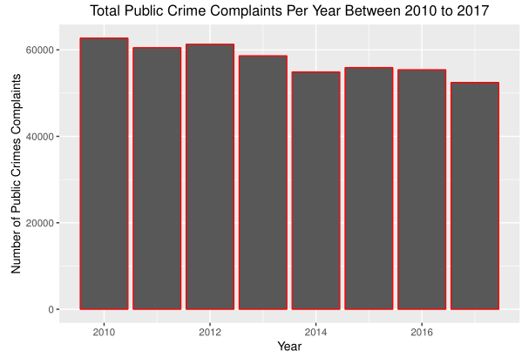
Data Visualization I
There is a decrease of 16.38% in the number of public crime complaints in 2010 and 2017.

Slide 9
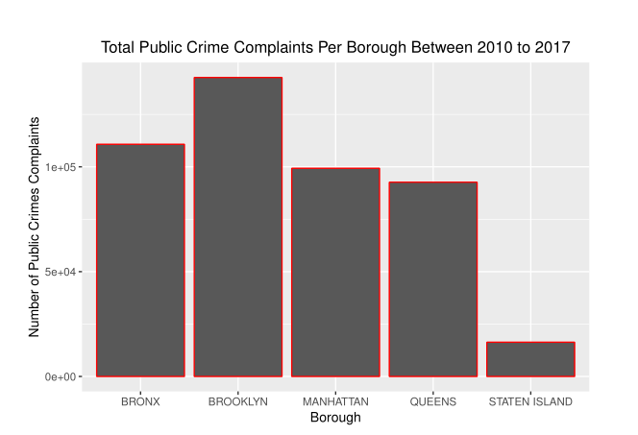
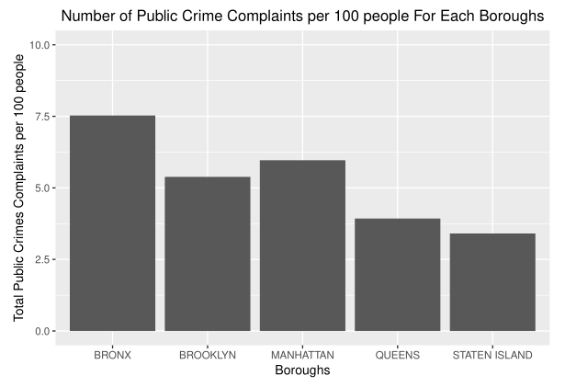
Data Visualization II: Boroughs
Brooklyn has the most number of public crime complaints.
After finding the number of public crime complaints per capita, Bronx has the most number of public crime complaints per 100 people.

Slide 10
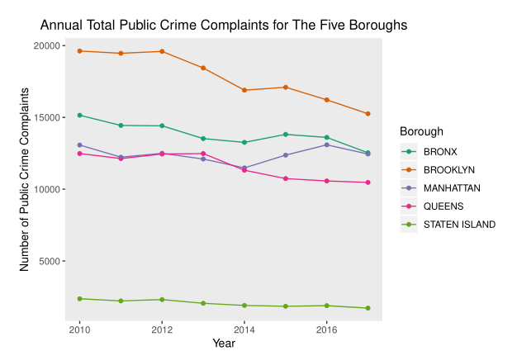
Data Visualization II: Boroughs
The public crime complaints have decreased for all five boroughs at the end of 2017.
Bronx decreased 17.3%, Brooklyn decreased 22.2%, Manhattan decreased 6.5%, Queens decreased 5.8%, and Staten Island decreased 27.5%.

Slide 11
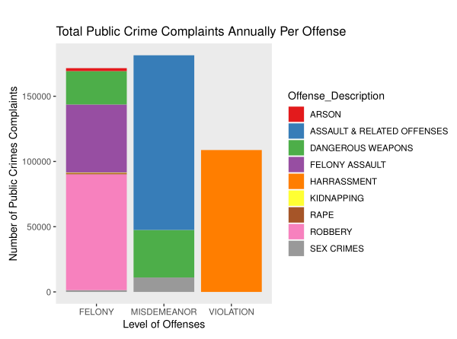
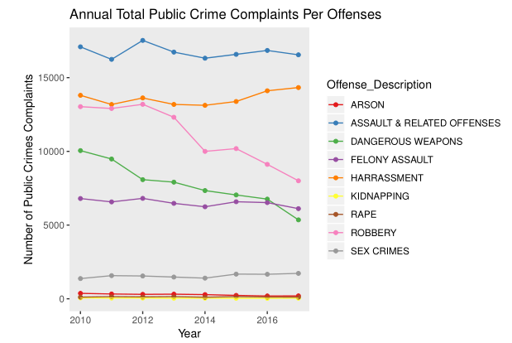
Data Visualization III: Level of offenses/ Offenses Description
Each of the offenses displayed in their level of offenses.
Arson decreased by 46.4%
Assault & related offenses decreased by 3.2%,
Possession of dangerous weapons have decreased by 46.7%
Felony assault decreased by 10.1%
Harassment increased by 3.8%
Kidnapping decreased by 31.3%
Rape is unchanged
Robbery decreased by 38.6%
Sex crimes increased by 25.6%.

Slide 12
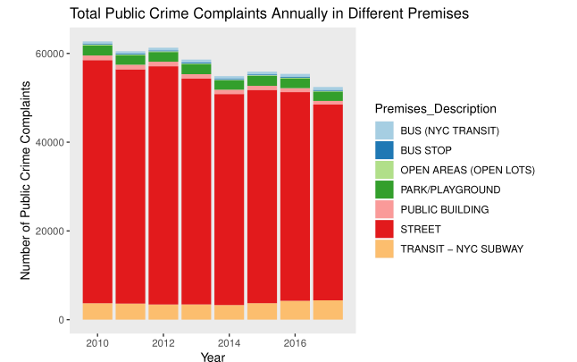
Data Visualization IV: Premises
Most of the premises in public crime complaints happened in the street.

Slide 13
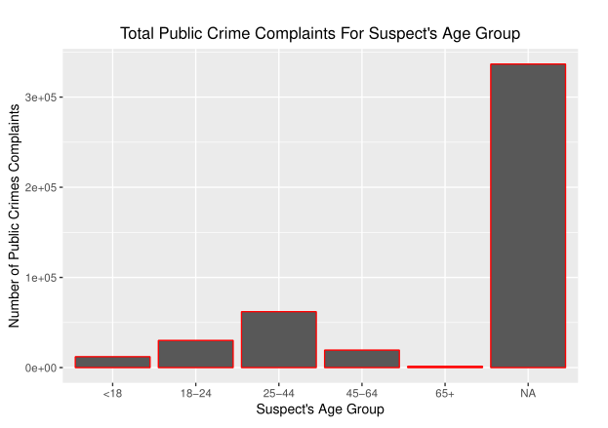
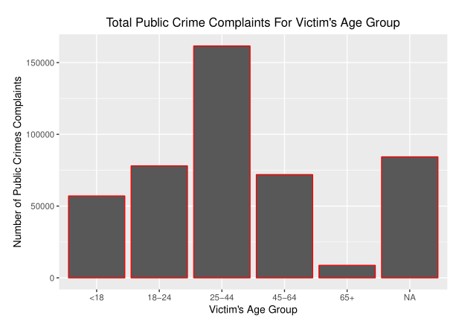
Data Visualization V: Suspects’ and Victims’ Age Group
Majority of the suspects that were reported were in the age group of 20 – 44.
Majority of the victims that were reported were also in the age group of 20 – 44.

Slide 14
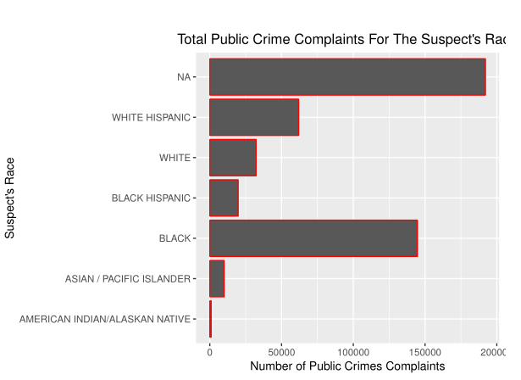
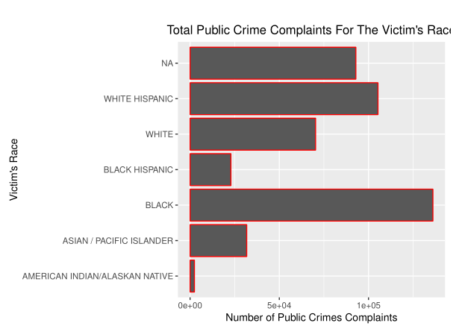
Data Visualization V: Suspects’ and Victims’ Race
Majority of the suspects that were reported were Black
Majority of the victims that were reported were also Black.

Slide 15
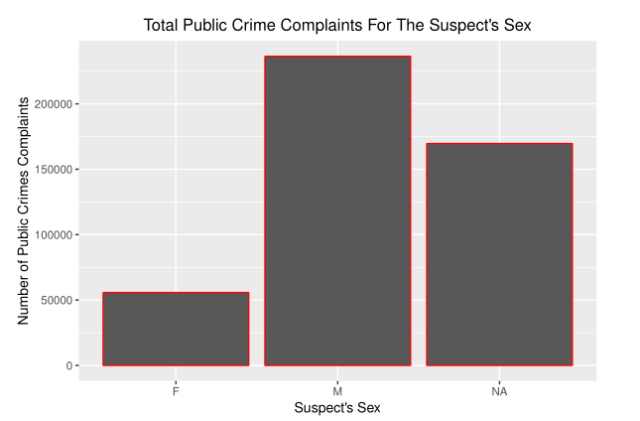
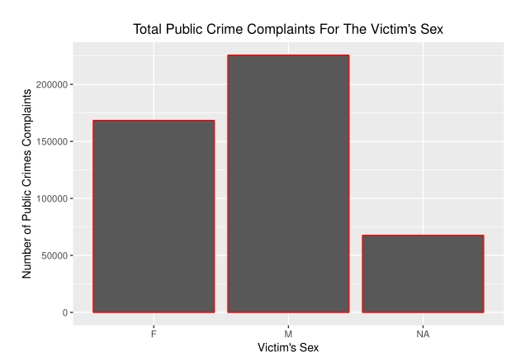
Data Visualization V: Suspects’ and Victims’ Sex
There were more than quadrupled male suspects reported than female suspects.
The male and female victims are more normalized.

Slide 16
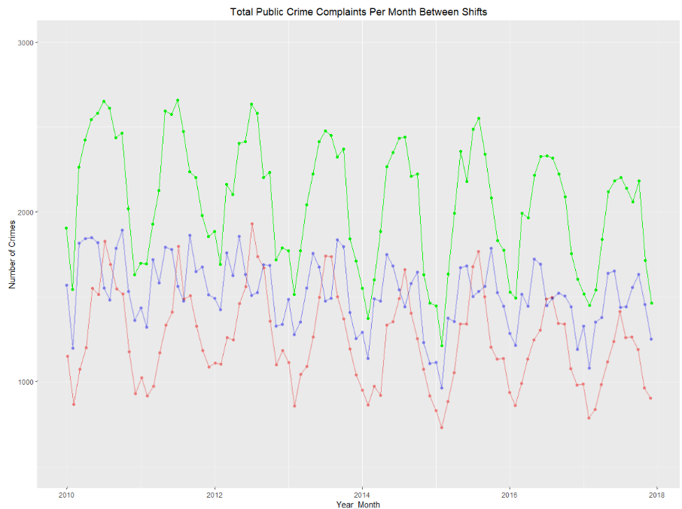
Data Visualization V: Comparing 3 Shifts
Time series of the number of public crime complaints during the three shift3. Red: Shift1, Blue: Shift2, Green: Shift3.

Slide 17
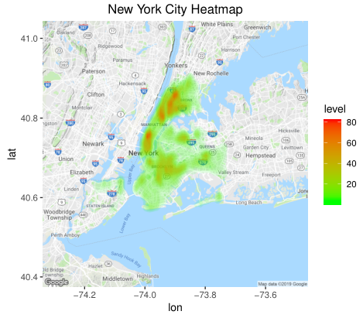
Heatmap: NYC
New York City Hotspots:
Lower Manhattan
Upper Manhattan
Lower Left of Bronx

Slide 18
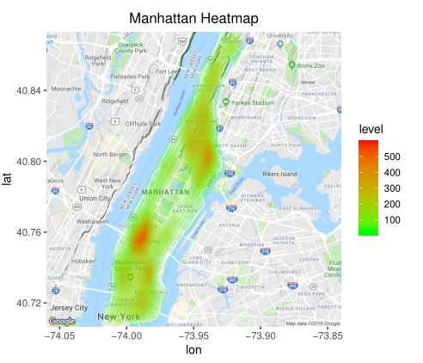
Heatmap: Manhattan
Manhattan Hotspots:
Between Hell's Kitchen
Midtown
Harlem
Upper Manhattan.

Slide 19
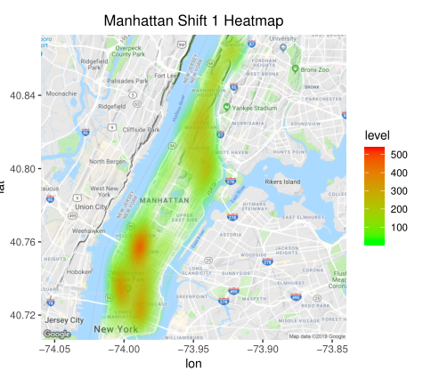
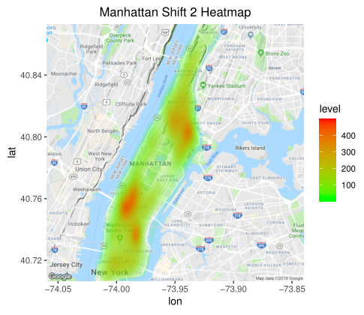
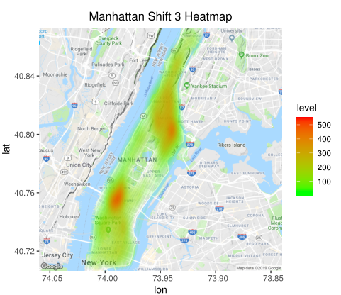
Heatmap: Manhattan Shifts
Manhattan During Shift 1 Hotspots:
Between Hell's Kitchen and Midtown
Lower Manhattan (Greenwich Village and Bowery).
Manhattan During Shift 2 Hotspots:
Between Hell's Kitchen and Midtown
East Village
Between Harlem and East Harlem.
Manhattan During Shift 3 Hotspots:
Between Hell's Kitchen and Midtown
Between Harlem and East Harlem.

Slide 20
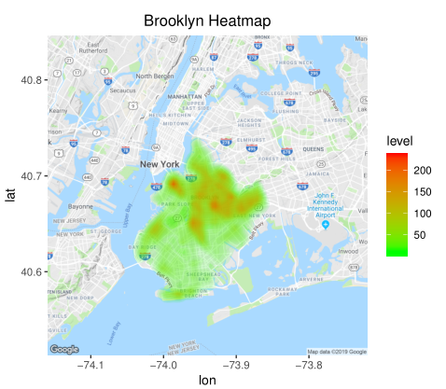
Heatmap: Brooklyn
Brooklyn Hotspots:
Everywhere in the middle of Brooklyn Height
Flatbush Ditmas Park
Highlands Park.

Slide 21
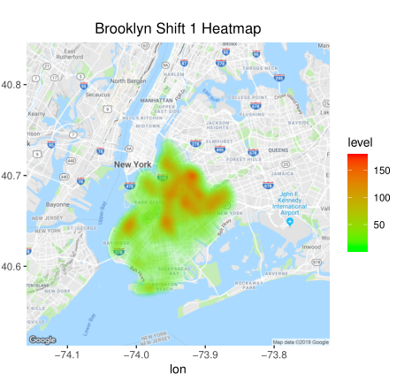
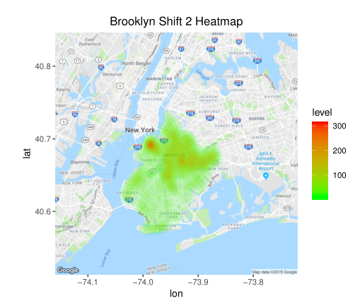
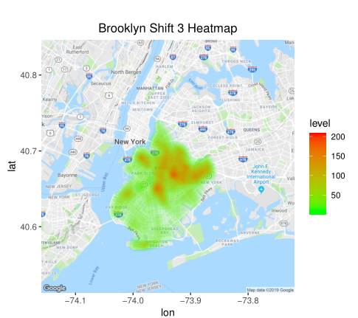
Heatmap: Brooklyn Shifts
Brooklyn During Shift 1 Hotspots:
Sunset Park
Upper half of Brooklyn.
Brooklyn During Shift 2 Hotspots:
Brooklyn Heights.
Brooklyn During Shift 3 Hotspots:
Upper half of Brooklyn.

Slide 22
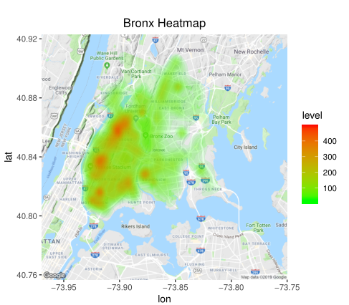
Heatmap: Bronx
Bronx Hotspots:
Fordham Heights
Morrisania
Mott Haven
Soundview

Slide 23
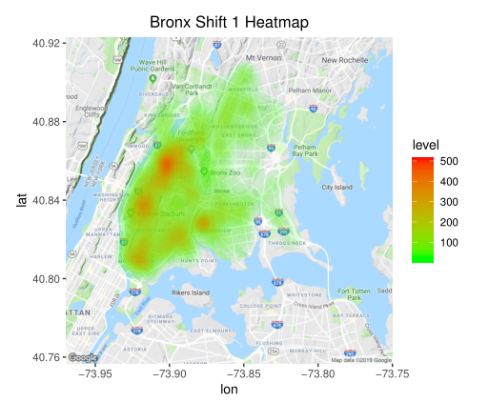
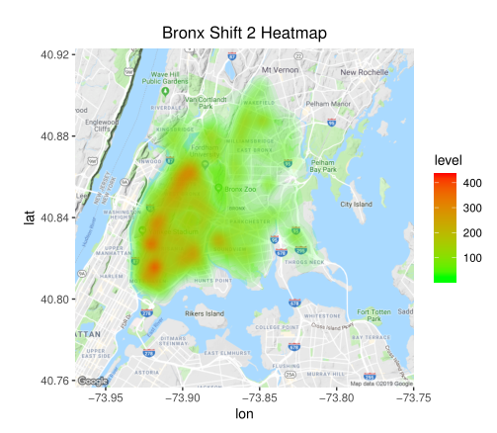
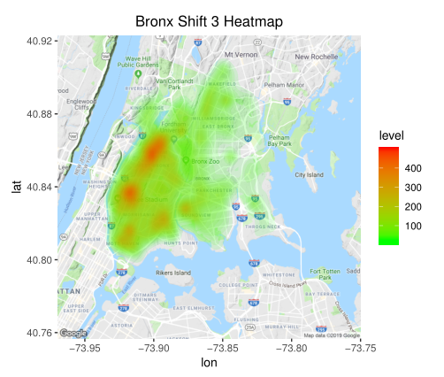
Heatmap: Bronx Shifts
Bronx During Shift 1 Hotspots:
Morris Heights
Highbridge
Mott Haven
Morrisania
Soundview
Bronx During Shift 2 Hotspots:
Morris Heights
Highbridge
Mott Haven
Morrisania
Soundview
Bronx During Shift 3 Hotspots:
Morris Heights
Highbridge

Slide 24
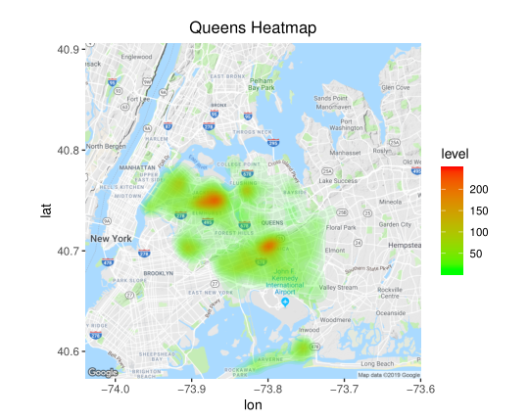
Heatmap: Queens
Queens Hotspots:
Jackson Heights
Jamaica

Slide 25
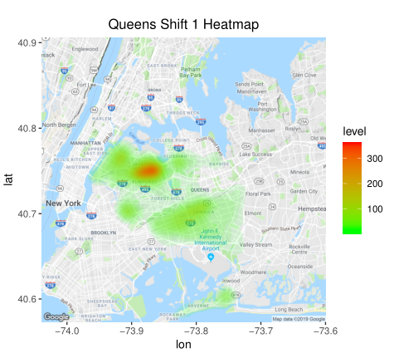
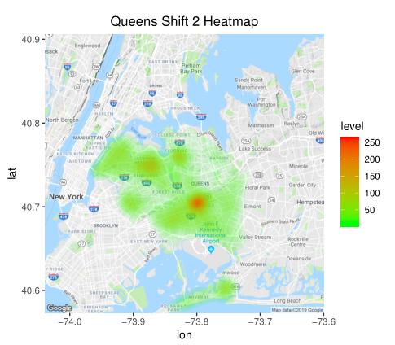
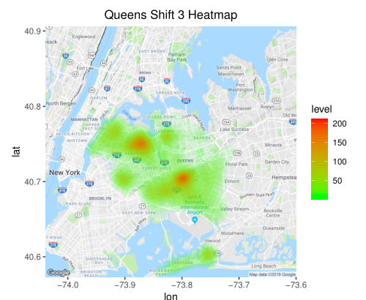
Heatmap: Queens Shifts
Queens During Shift 1 Hotspots:
Jackson Heights
Queens During Shift 2 Hotspots:
Jamaica
Queens During Shift 3 Hotspots
Jackson Heights
Jamaica

Slide 26
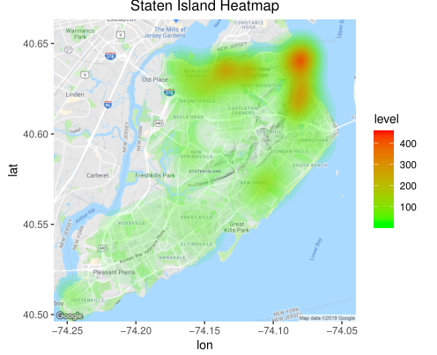
Heatmap: Staten Island
Staten Island Hotspots:
ST. George
Snug Harbor Cultural Center &
Botanical Garden.

Slide 27
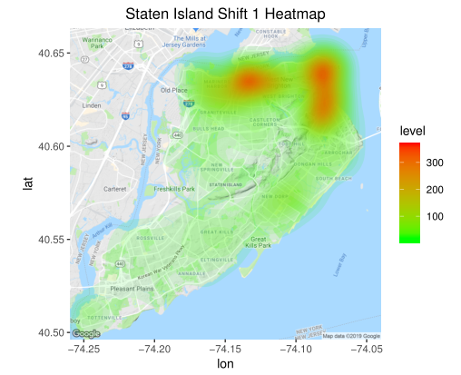
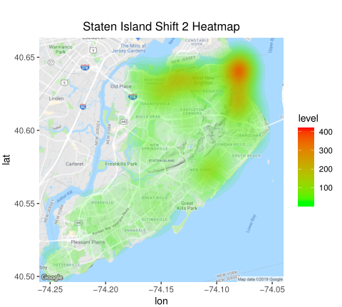
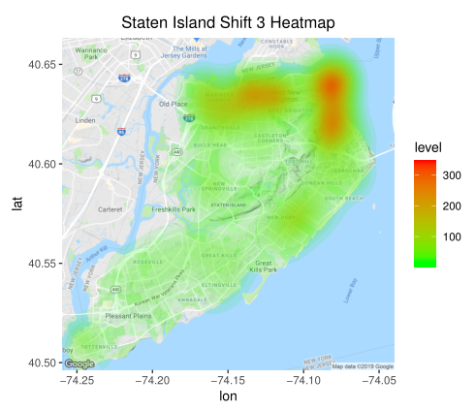
Heatmap: Staten Island Shifts
Staten Island During Shift 1 Hotspots:
ST George
Tompkinsville
Snug Harbor Cultural Center
& Botanical Garden.
Staten Island During Shift 2 Hotspots:
ST George.
Staten Island During Shift 3 Hotspots:
ST George
Tompkinsville
Snug Harbor Cultural Center
& Botanical Garden.

Slide 28
Linear Regression
Linear Regression model
Pareto Principle
Training Data(80% of the data)
Testing Data(20% of the data)
Explanatory variables
Average Temperature
Precipitation greater than 3 inches
Federal Holiday
Public Schools Closed

Slide 29
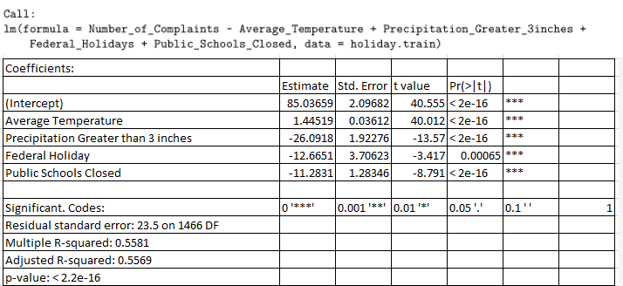
Linear Regression

Slide 30
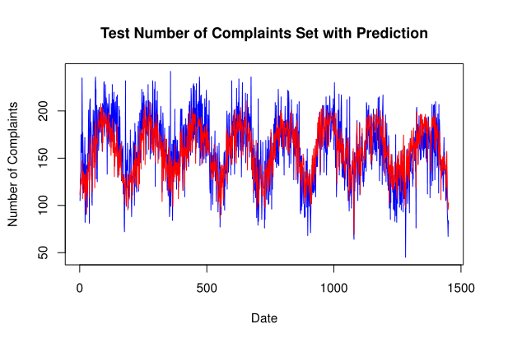
Linear Regression
The test set number of complaints is in blue and the prediction set of complaints is in red. The prediction set of complaints have a very similar trend to the test set of complaints.

Slide 31
Conclusion
At the end of 2017, the public crime complaints in New York City have decreased by 16.38%.
Brooklyn is the borough in New York City that has the most public crime complaints, but Bronx has the most number of public crime complaints if it was counted by per capita.
There is a low-moderate effect of 0.482 (R-squared) between the number of public crime complaints and weather temperature. But after adding the independent variable of the day: if the day's precipitation is great than 3 inches, if the day is federal holiday, and if public school are closed that day, the R-square increased to 0.5488. In the model that I created, the slope of the average temperature is 1.44, so 1 degree increase in Fahrenheit, it will increases the crime complaints by 1.44. Vice versa when 1 degree decrease in Fahrenheit, it will decreases the crime complaints by 1.44.
Most of the crime complaint reports are reported during Shift 3 (16:00 - 24:00).
To avoid the hotspots for the five borough, the heatmaps of each borough along shifts time of each borough are shown above.

Slide 32
Further Research and Recommendation
A potential further work that could be added can be the use of the shiny application, by making a public shiny application of the heatmaps for the hotspots. Locals and tourists can access more easily for their own safety concerns.
The police force can post up the heatmaps of the hotspots along with the crime complaints dataset to alert the locals and tourists about the public crimes.
The police force can use the three shifts' data along with the heatmaps to determine and/or adjust the number of police on duty to patrol certain area.
The police force can use the prediction of the linear regression model as an example to determine and/or adjust the number of police on duty to patrol on that day.

